Slide 1

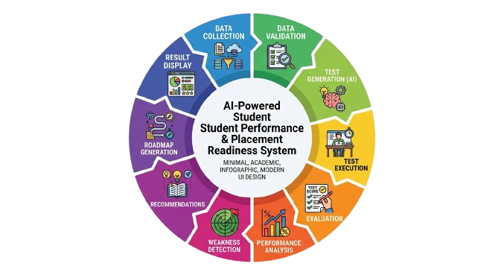

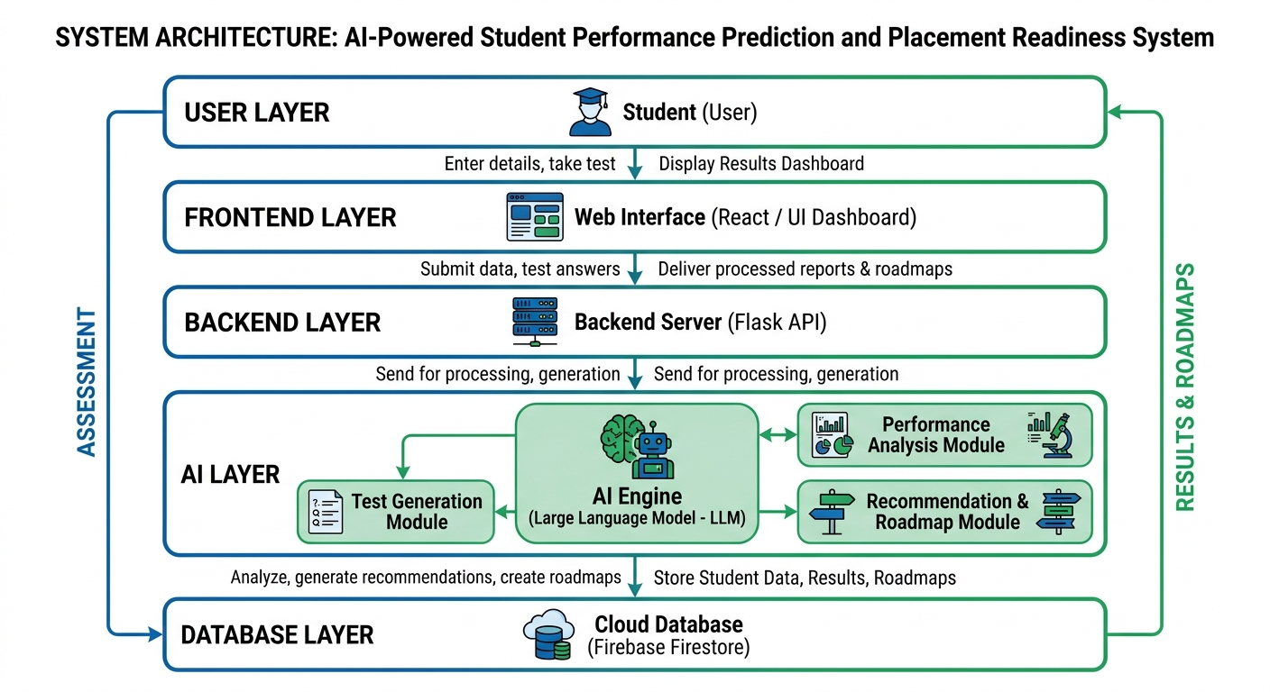
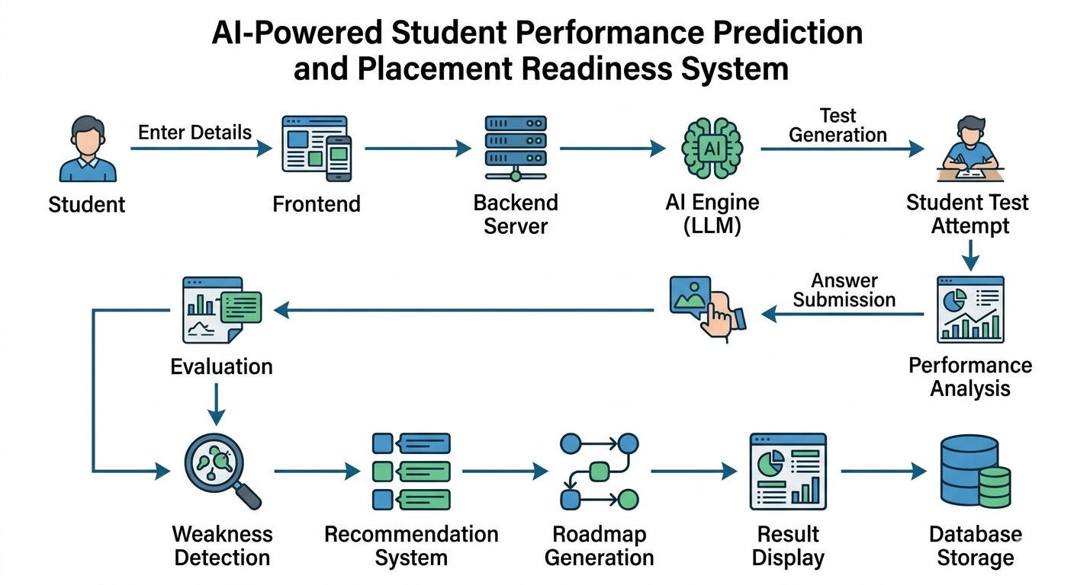
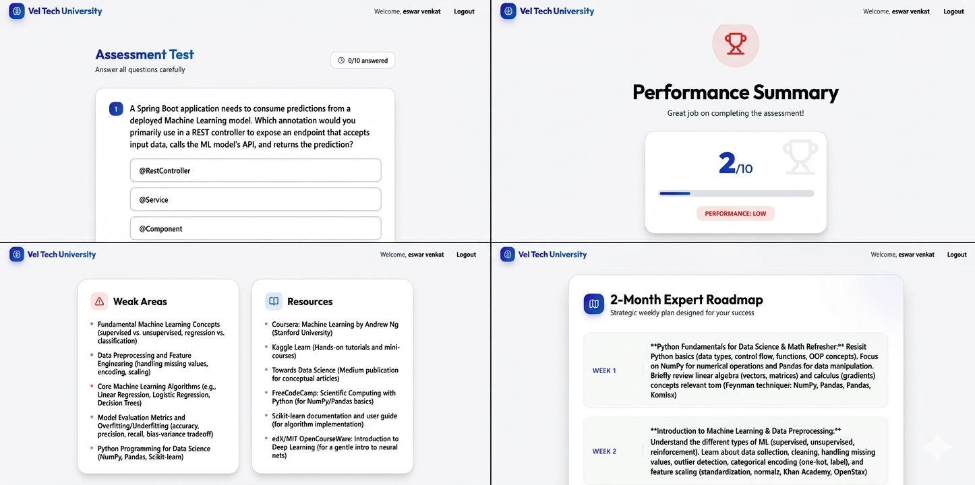
AI-Powered Student Performance Prediction and Placement Readiness System
Department of Artificial Intelligence & Machine Learning
School of Computing
10214AM602 – MINOR PROJECT - II
ABSTRACT
INTRODUCTION
ARCHITECTURE DIAGRAM
WORKFLOW
This project presents an AI-based system designed to improve student placement readiness by analyzing academic performance, skills, and domain interests. The system uses a Large Language Model (LLM) to generate domain-specific tests, evaluate student responses, and identify weak areas.
Based on performance analysis, the system provides personalized recommendations and a structured roadmap to guide students in improving their skills. The platform integrates frontend, backend, AI engine, and cloud database to deliver real-time insights and feedback.
The proposed system reduces the gap between academic learning and industry requirements by offering intelligent assessment and continuous improvement strategies, thereby enhancing placement success rates.
In today’s highly competitive job market, students must possess strong technical skills, domain knowledge, and practical problem-solving abilities to secure placements. However, traditional evaluation systems mainly focus on academic marks and fail to assess real-world readiness, which creates a gap between student capabilities and industry expectations.
To address this issue, this project proposes an AI-Powered Student Performance Prediction and Placement Readiness System. The system leverages Artificial Intelligence and Large Language Models (LLMs) to evaluate students through domain-specific tests. It analyzes student responses to identify strengths and weaknesses in different areas.
Based on the analysis, the system provides personalized recommendations and generates a structured learning roadmap. This helps students focus on improving specific skills and prepares them more effectively for placement opportunities, thereby increasing their chances of success.
METHODOLOGIES
RESULTS
CONCLUSIONS
• Data Collection: Collect student details such as skills, projects, and domain.
• Data Validation: Validate input data to ensure accuracy.
• Test Generation: AI (LLM) generates domain-specific questions.
• Test Execution: Student attempts the test through the system.
• Evaluation: System evaluates answers and calculates score.
• Performance Analysis: AI identifies strengths and weak areas.
• Recommendation: Provide learning resources based on performance.
• Roadmap Generation: Generate a step-by-step improvement plan.
• Data Storage: Store results in the database.
• Result Display: Show score, recommendations, and roadmap.
The AI-Powered Student Performance Prediction and Placement Readiness System provides an effective solution to improve student preparation for placements. The system evaluates student performance using AI-generated tests and identifies weak areas accurately.
It offers personalized recommendations and a structured roadmap, helping students focus on skill improvement. By integrating AI, web technologies, and cloud databases, the system enhances learning efficiency and bridges the gap between academic knowledge and industry requirements.
TEAM MEMBER DETAILS
1. SRI DEEKSHITHA GUMMALLA
VTU28350
Ph no: 8142995791
Mail:VTU28250@veltech.edu.in
2. ESWAR VENKAT KASTURI
VTU28351
Ph no:8125884008
Mail:VTU28351veltech.edu.in
SUPERVISOR
Name: Alex David S B.E., M.Tech., Ph.D.
Ph no: 79042 41134
Mail: adstechlearning@gmail.com
Figure 1. Dashboard

